Slide 1
Report of Task 2
By
Shelke Bapu Anil

Slide 2
Title: Automatic Vulnerability Scanner
Out-of-date Version (OpenSSL)
Tool Used: Netsparker
Domain: https://webappsecurity.com/
Subdomain: https://zero.webappsecurity.com/
Current Version: 0.9.8e (contains 5 critical and 107 other vulnerabilities)
Latest Version: 1.1.1k
Vulnerability Database: Result is based on 30-07-2021 vulnerability database content.
Vulnerability Details:
The tool netsparker identified that the website is using an outdated version of OpenSSL

Slide 3
Steps:
Step 1: Add Website you want to s to the dialogue box.
Step 2: Define the customization option to scan as per your need
Step 3: It will start scanning it automatically
Step 4: Choose any one of the Critical Vulnerabilities.
Step 5: Write Reports for the vulnerability you wanted to write. Make sure the report should not be the same as in Netsparker.

Slide 4
Impact:
Since this is an old version of the software, it may be vulnerable to attacks.
Remedy:
Please upgrade your installation of OpenSSL to the latest stable version as soon as possible.

Slide 5
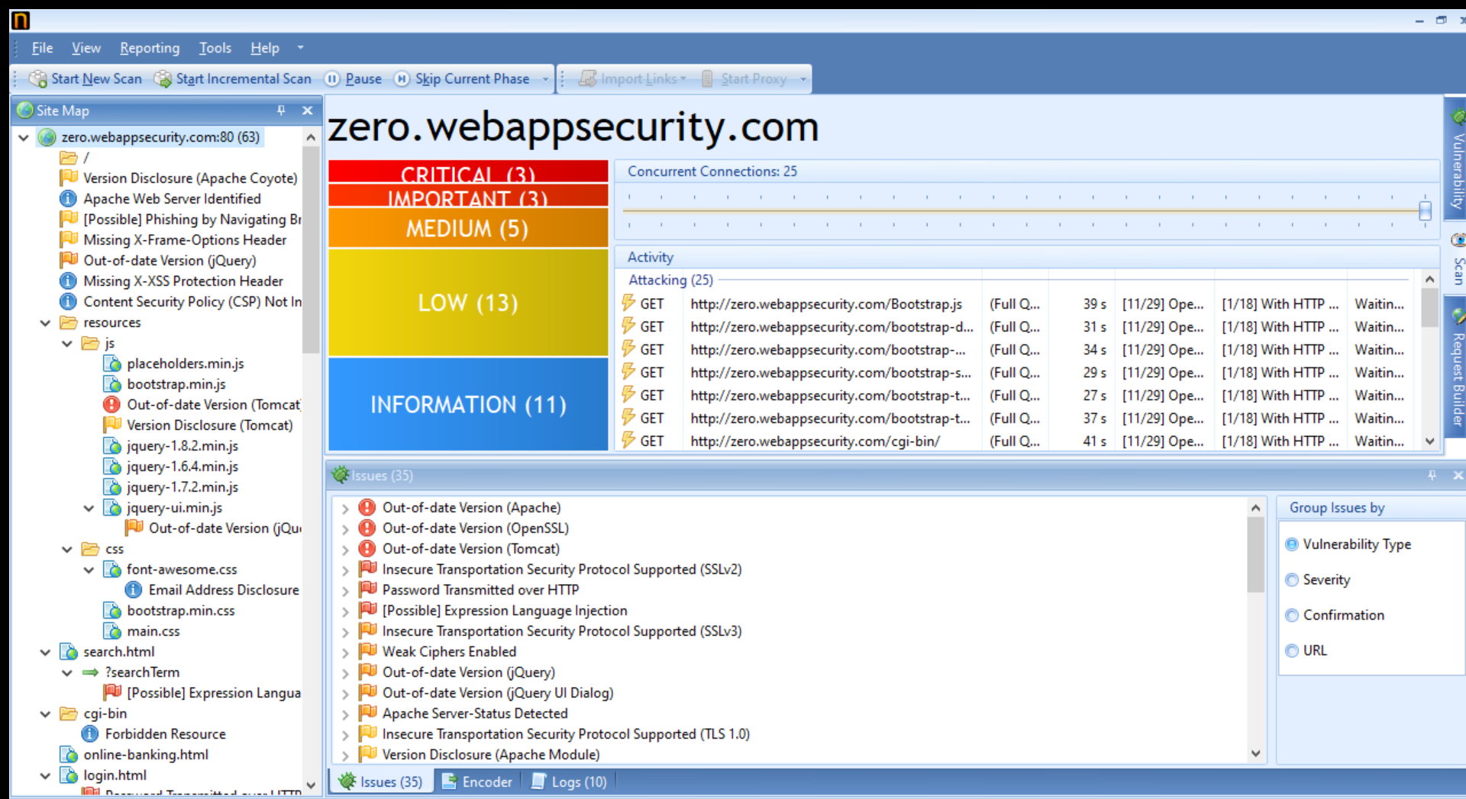

Slide 6
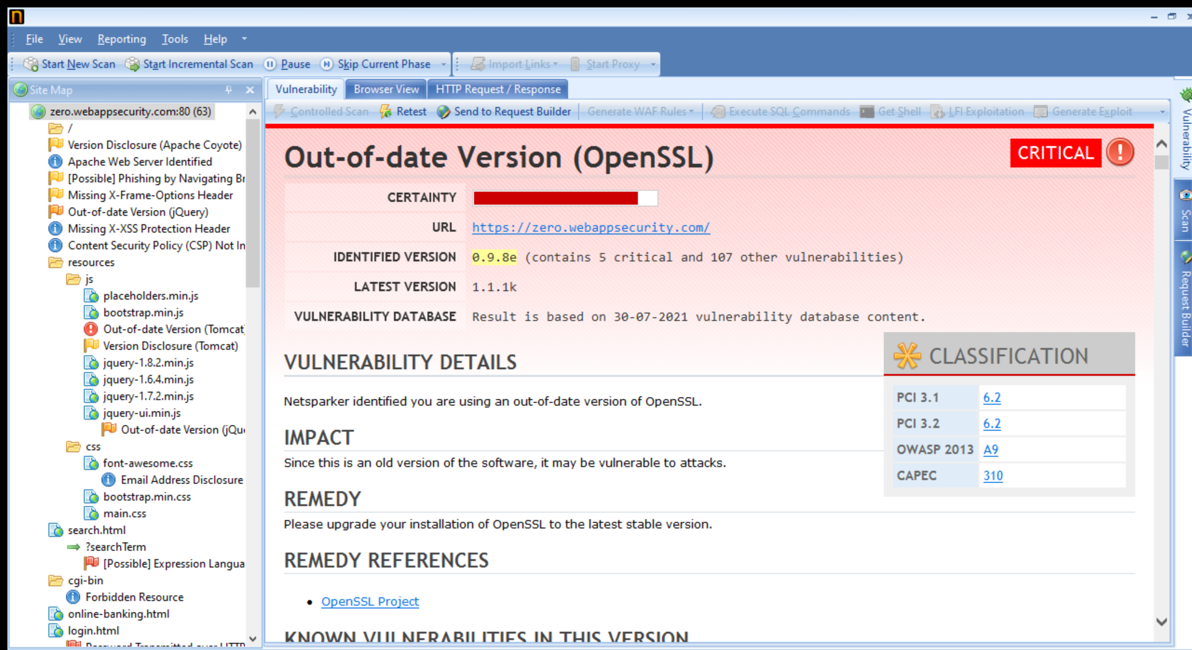

Slide 7

Thank You

